Slide 1


BUSINESS TRACK · PRICING CASE
Pricing Across a Product's Lifecycle:
The New-to-Online Seller
Sahi Daam: Helping new-to-online sellers find, and keep, the right price
[Team Name -NoName] | [Members –Deeksha Dey, Himanshi Vaidya, Aashish Gaurabh] | [College –IIT ISM Dhanbad]

Slide 2




Executive Summary
Pricing across a product's lifecycle for the new-to-online seller
The Problem
New-to-online sellers set a day-one price by guesswork: they carry over the offline price, copy the cheapest competitor or price too high. The price then goes stale. Result: invisible losses per order, lost discovery, abandoned listings and churn.
Strategies
Price from the Floor up. Every listing starts from the true cost to serve a delivered order: landed cost + shipping, fees & GST + expected returns/RTO + ads.
What We Are Really Solving
Sellers don't lack a price. They lack three things:
FLOOR
CEILING
SIGNAL
Three-zone Smart Band. Upgrade Meesho's competitor-led Price Recommendation into Win / Profit / Loss zones marked against the seller's own floor. Never recommend below it.
True cost to serve a delivered order, incl. returns & RTO
The price band buyers actually accept
An alert when the price has gone wrong
Listing Health Guard. Sanity-check weight and dimensions before they move the shipping slab. In our interview, a 750 g combo was billed as 7,500 g.
Impact Potential & Business Opportunity
SELLER PRICING PROBLEM
RIGHT PRICING
Lifecycle Autopilot. Trigger-based nudges in the seller's language (conversion drop, cost change, settlement drift, season end) with the rupee impact of each action.
BETTER PRICING DECISIONS
SELLER IMPACT
↑ Profitability
↑ Trust
↑ Survival
Settlement Explainer. Itemised, plain-language payouts with expected-vs-actual alerts; pricing-critical tickets verified before they close.
BUSINESS IMPACT
↑ Retention
↑ Healthy Listings
↑ GMV
Key Evidence
10×
500+ → 8–10
26% vs <2%
0 of 4
billable vs actual weight in the interviewed seller's listing (750 g → 7,500 g)
orders/day for the same seller, ~2 years apart
RTO on COD vs prepaid orders in India (Shipway)
benchmarked platforms recommend a price floor from the seller's own cost and returns

Slide 3
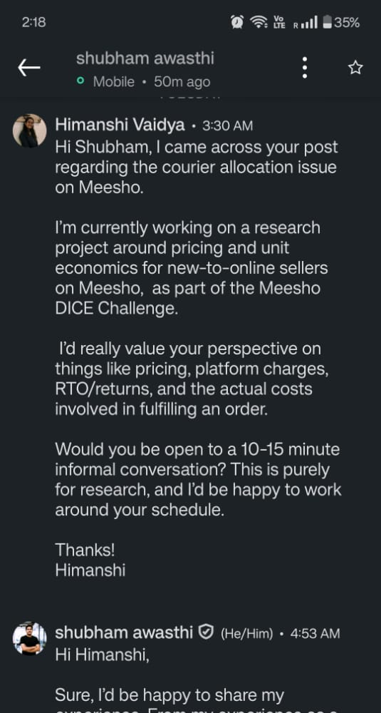
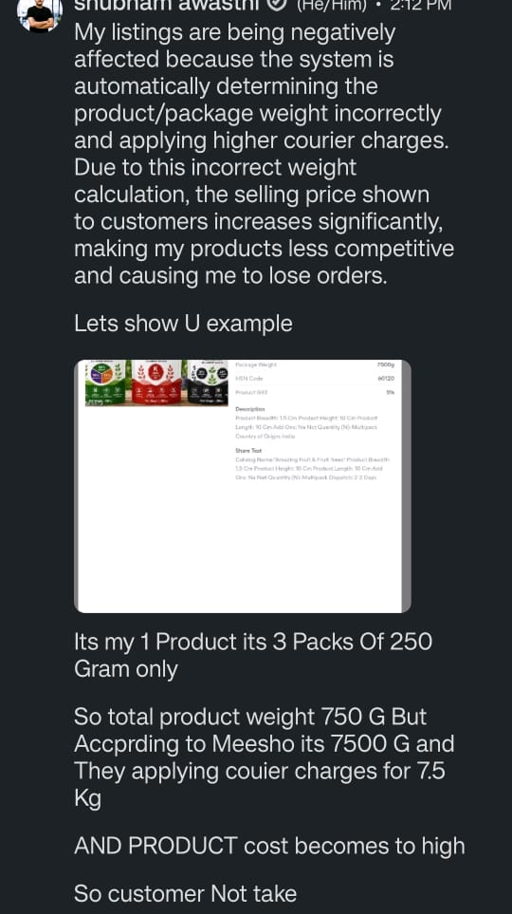
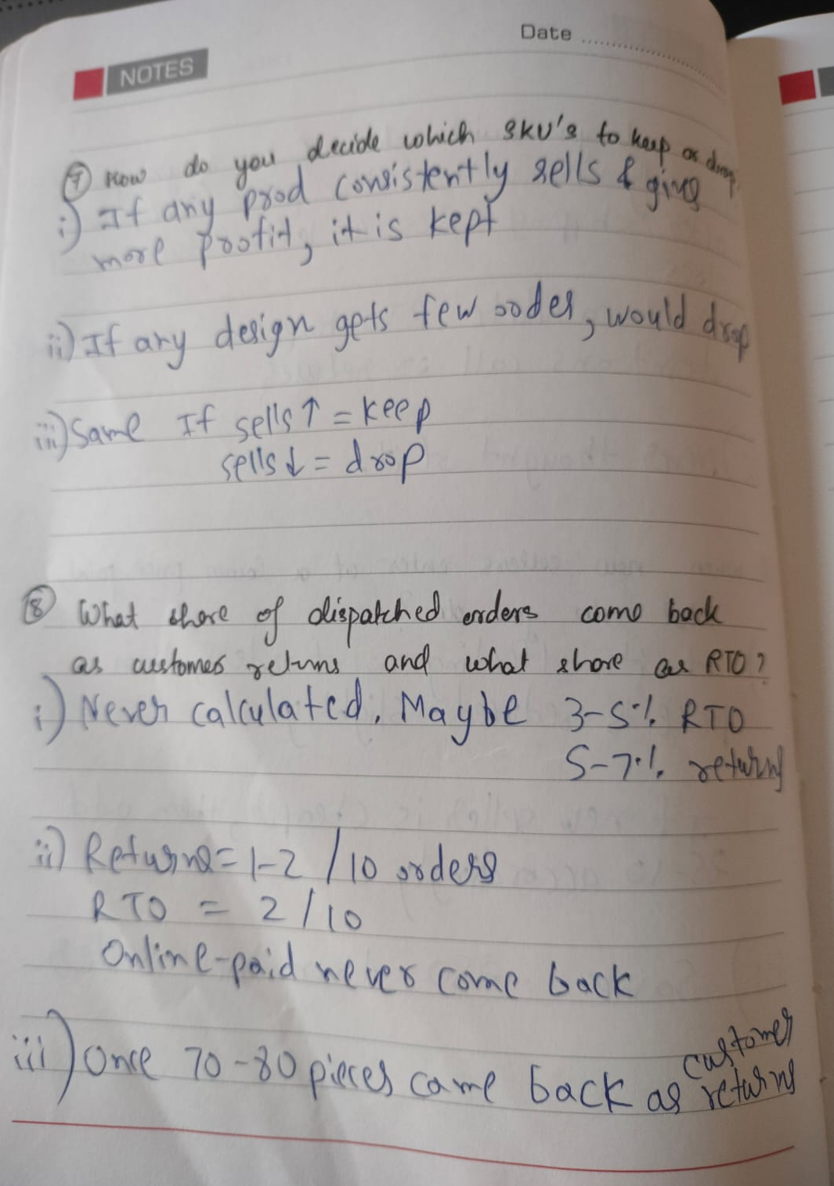










Research: Seller Voice & Benchmarking
What sellers told us, and how marketplaces help sellers price today
Evidence from the field
Interview artefacts kept on file
Seller | Opinion | Problem | Problem Area | Pricing Implication
● Organic fertiliser combo Meesho seller, interviewed | "Due to this incorrect weight calculation, the selling price shown to customers increases significantly… causing me to lose orders." | ❖ 750 g pack billed as 7,500 g ❖ Orders 500+/day → 8–10/day ❖ Tickets closed with generic replies | ❑ Input accuracy ❑ Support & trust | ✓ Weight sanity check + alert before slab change ✓ Itemised settlement, human escalation
◇ Ethnic-wear wholesaler Surat · 11 yrs offline, 1 yr online | "Market decides price, not me. If I increase ₹20, orders stop." | ❖ Prices at competitor median ❖ Doesn't know net payout ❖ ~8–9 of 30 orders come back | ❑ Market anchoring ❑ Returns | ✓ Show floor vs market band ✓ Price expected returns into the floor
◇ Kitchen & plastics trader Purana Bazar, Dhanbad · 5 months online | "Shop me 320 chalta hai, so online bhi 320. Nobody told me box size matters." | ❖ Offline price carried over ❖ Bulky rack nets only ₹60–70 ❖ "Cost" = purchase rate | ❑ Hidden shipping cost ❑ Pricing literacy | ✓ Cost-to-serve wizard at listing ✓ SKU viability check for bulky items
◇ Jewellery seller Damodarpur, Dhanbad · Instagram-first, 2 yrs | "My pricing is basically one step above the cheapest guy. Sheet price is kind of useless." | ❖ Sheet says ₹139, market ₹99–109 ❖ Inputs 8 months stale ❖ COD RTO ~20% in some pin codes | ❑ Stale inputs ❑ COD RTO | ✓ Auto-refreshed inputs & drift alerts ✓ RTO priors by pin & payment mode
◇ Winterwear seller Hirapur, Dhanbad · churned after 2 seasons | "Weight they decide, return they decide, claim they reject, payment they cut." | ❖ Undercut rivals by ₹50 ❖ 70–80 late returns became dead stock | ❑ Seasonality ❑ Control & trust | ✓ Season-end markdown to cash floor ✓ Settlement explainer
Seller's Voice
LinkedIn outreach
& first reply
750 g billed
as 7,500 g
Field notes:
SKUs, returns, RTO
Voices mapped
· ◇ 1 linkedin· ◇ 3 In-person ◇ 1 phone call
SOURCE
MEESHO (TODAY)
AMAZON
FLIPKART
WALMART MARKETPLACE
Competitor &
demand data
Price
Recommendation
Seller accepts
or edits
Revenue
Calculator
Pricing
Health
Automate
Pricing
Market
trends
Price Rec.
Tool
Paid account
manager
Seller min &
max price
Repricer
Pricing
Insights
Price Recommendation: competitive price + transfer price shown
Smart pricing: auto-adjusts within seller min/max
Dual price: lower price if only wrong/defective returns
Revenue Calculator: profit estimate from fees
Pricing Health: flags pricing errors, offers near Featured Offer
Automate Pricing: competitive or sales-based rules
Price Recommendation Tool: price from market trends & insights
Seller Hub: sales, returns, inventory dashboards
Human help: offered as a paid service
Repricer: acts only within seller-set min & max price
Pricing Insights: competitiveness score, Buy Box win rate
Pricing rules: unpublish highly uncompetitive offers
Floor from seller's cost + returns? No
Strong ceiling signal; floor, weight check and lifecycle nudges missing
Floor from seller's cost + returns? No
Separates profit check from competitiveness; seller supplies own cost
Floor from seller's cost + returns? No
Guidance for low-literacy sellers sits behind a paywall
Floor from seller's cost + returns? No
Min price is a mandatory guardrail; account score acts as north star

Slide 4





How a Seller Should Reason to a Price
From true cost to a market-ready number, including the first price with no sales history
Why pricing breaks today: the Price-to-Bank journey of a new-to-online seller
Seller sets price
Listing data
Buyer sees price
Delivery outcome
Bank settlement
Offline price carried over or cheapest copied
"Cost" = purchase rate only
Weight & dimensions set the shipping slab
Return option picked blindly
Side-by-side, compared in seconds
Wrong slab → inflated price → no orders
COD RTO ~26%; fashion returns 25–40%
Wardrobing, swaps, false claims
Shipping + 18% GST on fees + TCS/TDS
"Meesho transfers less than I listed"
Seller Pricing Logic: Floor → Ceiling → Position
Worked Example: Kurti Set (illustrative)
1 FLOOR
2 CEILING
3 POSITION
C landed cost ₹190
S ship + fees + GST ₹77
f returns + RTO 30%
What must every order cover?
What will buyers pay?
Where in the band?
F cost per failure ₹150
A ads per order ₹8
Band market ₹289–319
P₀ = C + S + (f·F + A) ÷ (1 − f)
Minimum price = P₀ + target profit
C=landed cost (product, packing, labour), S=shipping + fees + GST, f=share of orders returned or RTO,
F=cost per failed order, A=ads per order
Band of comparable listings: lower to upper quartile, not just the cheapest
Meesho Price Recommendation
Offline price: sanity check only
Floor below band: launch low-to-mid, step up later
Floor inside band: price at floor+, win on photos, ratings, fewer returns
Floor above band: pull a lever or don't list
Scenario | Floor P₀ | Profit at ₹299
Base case (f = 30%) | ₹343 | −₹31 per order
Defective-only returns (f → 15%) | ₹303 | −₹3 per order
…plus ₹15 lower landed cost | ₹288 | +₹9 per order
↑ Move up the band: ratings & reviews · better photos · genuine differentiation (handmade, material) · prepaid-heavy demand · fast dispatch
↓ Stay low in the band: no ratings yet · high COD share · high-return category · many near-identical listings
Profit per dispatched order at market price ₹299
−₹31
Base case
Setting the very first price (no sales history)
−₹3
Defective-only returns
1 Borrow category priors for returns, RTO, shipping & price band
2 Verify weight & dimensions before listing
3 Launch test: ~14 days or ~1,000 views
4 Swap priors for own data after ~30–50 orders
+₹9 + lower cost
Copying the market looks safe but loses ₹31 on every dispatched order. The real choice is which lever makes the SKU viable, or not listing it.

Slide 5






Lifecycle Pricing & How Meesho Helps
Signals and triggers that change the price, and Sahi Daam, Meesho's pricing co-pilot
Lifecycle Playbook: signals to watch and triggers that change the price
Launch (0–30 days)
Growth
Maturity
Decline / Season end
Always-on triggers
Goal: Get discovered, stay profitable
Goal: Turn momentum into margin
Goal: Defend profit as the market shifts
Goal: Recover cash from stock
Cost change (slab, weight, GST, raw material) → re-compute floor
Returns/RTO jump → update f; review return option, size chart
Festive window → plan price & ads early; pad RTO buffer
Sustained band shift → re-position, never below floor
Watch: Views, CTR, orders per 1,000 views, first returns
Watch: Order velocity, rating ≥ 4, returns vs category
Watch: Competitor band, settlement per order vs expected, input costs
Watch: Weeks of stock vs season left, late returns
Trigger → Action
Trigger → Action
Trigger → Action
Trigger → Action
Conversion < category median after ~1,000 views → fix photos, then test −5% (stay ≥ floor)
Few views → visibility problem, not price
Velocity up, conversion stable → +3–5% step, hold a week, keep if conversion holds
Returns below category → floor falls, bank the margin
Settlement drift > 5% → check weight & deductions before touching price
Band falls below floor → differentiate, pull a lever or exit
Stock outlasts selling window → markdown ladder to cash floor (C + S)
Slow SKU → bundle with a fast one; stop restocking
Sahi Daam ("the right price"): Meesho's Pricing Co-pilot in the Supplier App
What the Seller Sees
Success Metrics & Key Risks
Munafa Meter · Kurti set
North star: % of active listings priced above their floor and inside the market band
Munafa Meter
Smart Band
Listing Health Guard
Lifecycle Autopilot
Settlement Explainer
Loss
Win
Profit
↑ 90-day survival of new sellers
↑ Settlement-verified profit per order
↓ Days to first order (FY25 baseline: 16)
↓ Listings with no price review in 60+ days
Voice/vernacular cost wizard at listing; auto-fills slab, GST on fees, return & RTO priors; shows price → bank → profit
Win / Profit / Loss zones vs the seller's own floor; smart-pricing minimum defaults to floor; return option shown in ₹
Flags weight that doesn't fit size or contents; alert before slab change; photo-on-scale dispute, no auto-close
Watches playbook signals; one WhatsApp/app nudge at a time with ₹ impact; optional auto-apply
Itemised plain-language payout per order; expected vs actual drift alerts
Floor ₹288
Market ₹289–319 · Suggested ₹309
You keep ~₹18 per order after expected returns
WhatsApp nudge (Hindi/English)
"Views are good but orders are low. Try ₹299 for 7 days, you still make ~₹9 per order."
[ Apply ] [ Ignore ]
Risk → Mitigation
Seller journey
List
Price
Test
Grow
Clear
Tiers: Guided (voice, defaults) · Growing (bands, tests) · Pro (bulk, custom rules)
Price herding → ranges, not one price; seller decides
Race to bottom → floor is a hard guardrail
Wrong inputs → category sanity checks, defaults
Distrust, nudge fatigue → ₹-explained, trigger-only, vernacular
Why it's feasible: extends tools Meesho already ships (Price Recommendation, smart pricing, dual return price) with data it already holds (slabs, category returns, comparable listings).

